Slide 1
PPD and E
htinaung

Slide 2
DEFINITION
What is professionalism?

Slide 4
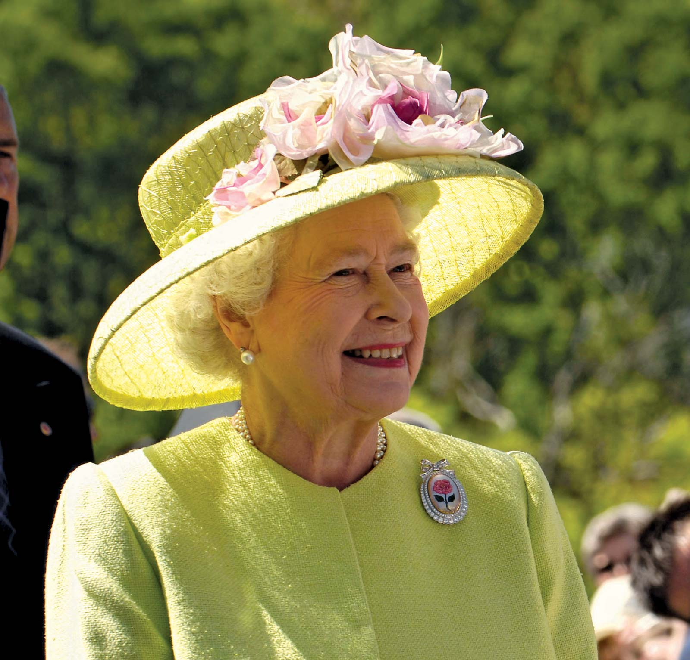
CAN ANYBODY BECOME A PROFESSIONAL?

Slide 5
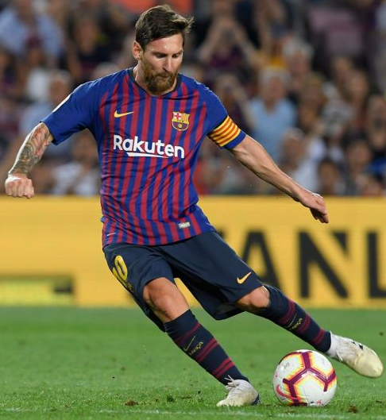
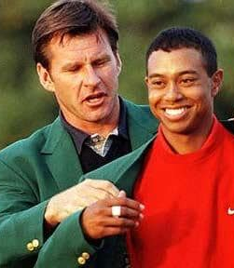
Professionalism is ACHIEVED !!!
It do not come automatically
NEED YEARS OF PERSEVERANCE AND PRACTICE

Slide 6
PROFESSION
Body of knowledge သုတ။
Scope of practice က်င့္ထံုး။
Agreed upon values တန္ဖိုး ၀ိနည္း။
Oath or Code က်မ္းသစၥာ။ စည္းမ်ဥ္း။
Accountability to society တာ၀န္ယူမွု။
for professional and
personal behaviour.

Slide 7
CHARACTERISTICS OF A PROFESSION
VALUE ORIENTATED SERVICE
AUTONOMY DECISION MAKING
ABSTRACT KNOWLEDGE
ဥါဏ္သေဘာျဖစ္ေသာ
အသိပညာ
၀န္ေဆာင္မႈ
လြတ္လပ္ေသာ ကိုယ္ပိုင္ ဆံုးျဖတ္ခ်က္္

Slide 8
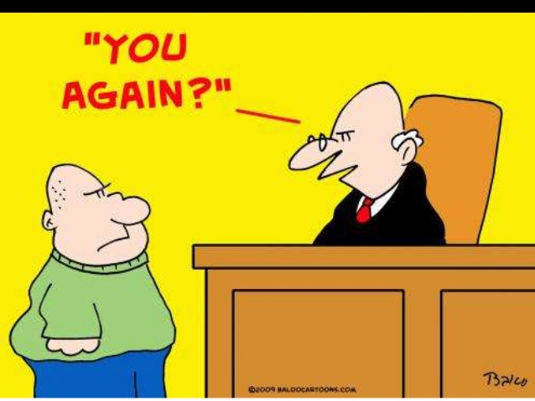
PROFESSIONALISM
Webster's Dictionary
"the conduct, aims, and behaviour that
characterize or mark a profession or
a person in the work place
BEHAVIOUR: အဇၨတ
response to a particular situation
CONDUCT: ဗဟိဒၵ
action, from the stand point of morality and ethics

Slide 10
Your clothing creates your image
Follow the dress code of
the organization
Dress brings uniformity to
the organization
It is part of organization culture
Do not dress provocatively
Dress to fit into the organization
Refrain from using heavily scented
perfume
APPEARANCE

Slide 11
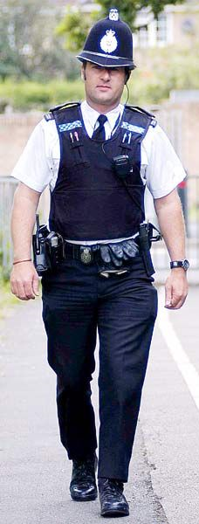
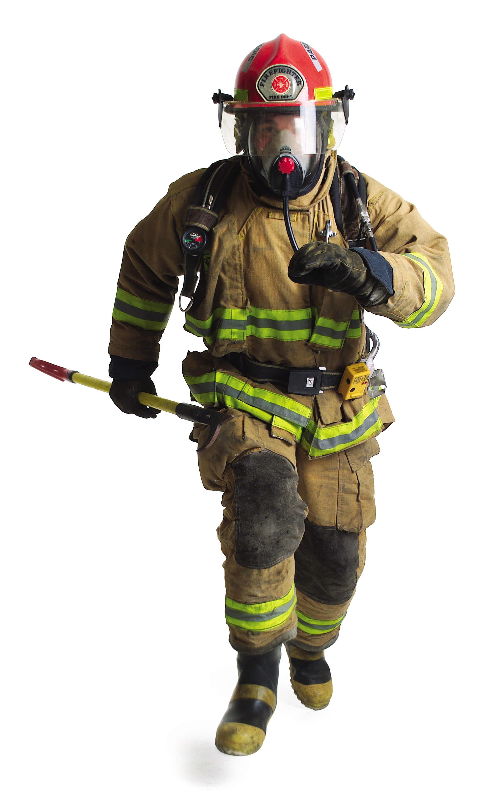
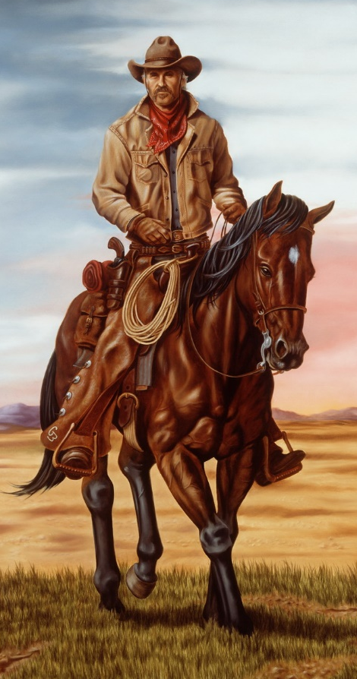

Slide 12
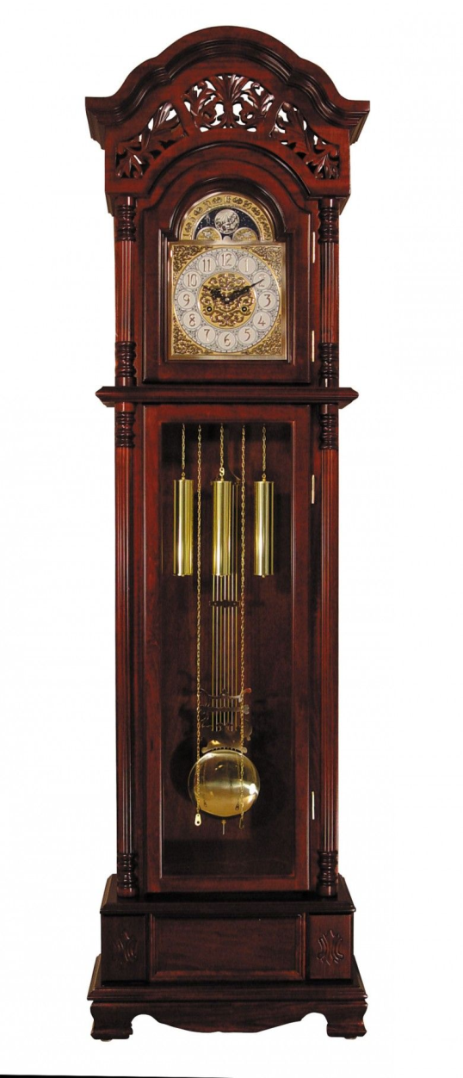
TIME MANAGEMENT
Show up on time [leave enough time for traffic]
Arrive early [15 mins. before starting work]
Meet all deadlines
Be counted as responsible and reliable
Multi-tasking
Set priorities for each day
Be abreast with daily schedule

Slide 13
ETHICAL STYLE ၀ိနည္းထိုေသာ။
Honesty [others and self]
Maintain confidentiality
Base action on sound rationale
Do not misrepresent
Believes the others recognise
the stature of a professional

Slide 14
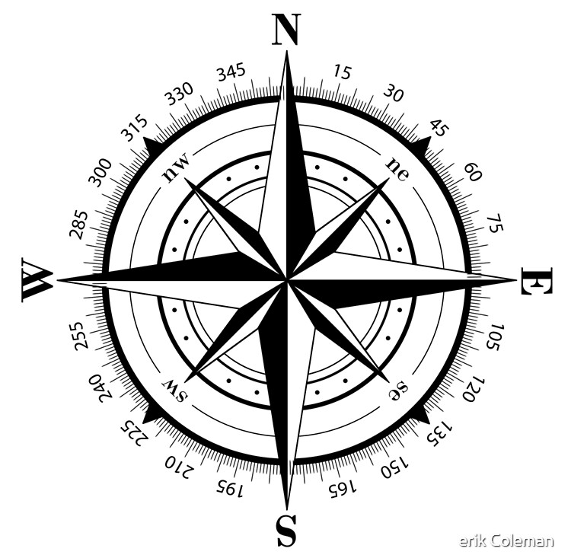
ALTRUISTIC STYLE အနစ္နာခံေသာ။
Behave unselfishly တကိုယ္ေကာငး္
Devote to interest of others
Show respect for others
Show positive attitude towards
co-workers, children, old-folks
and community

Slide 15
RESPONSIBLE STYLE တာ၀န္ယူမႈရွိေသာ။
Promise what you can deliver
Follow through
Say “NO” without guilt
Think before reacting
Foresee outcomes
Decide - based on possibilities
Consider the best interest of patient
EVALUATE: assess own contribution realistically

Slide 16
THEORETICAL သေဘာတရားယွဥ္ေသာ။
Practice critical thinking ဆန္းစစ္ ေ၀ဖန္
Knowledge based contributions
Appreciation for scholarship, research
and theory
Theoretical foundations of actions
EVALUATE: own professional practice
in the light of new conditions
and knowledge

Slide 17
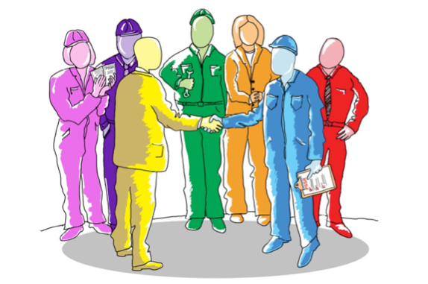
COMMITTED အလုပ္တြင္နွစ္ျမဳပ္ေသာ
Spend time beyond the call of duty
Become member of organisation
Take active part in organisation
Identify with organisation
(when praised or criticised)
Articulate the profession’s philosophy
to the public.

Slide 18
INTELLECTUAL STYLE ဥါဏ္အားေကာင္း
Read current journals
Keep abreast of technical advances
Read about related professions
Interact with colleagues
Participate in conferences
Attend courses and workshops
Develop performance skills
Strive towards self improvement

Slide 19
4-Cs to SUCCESS

Slide 20
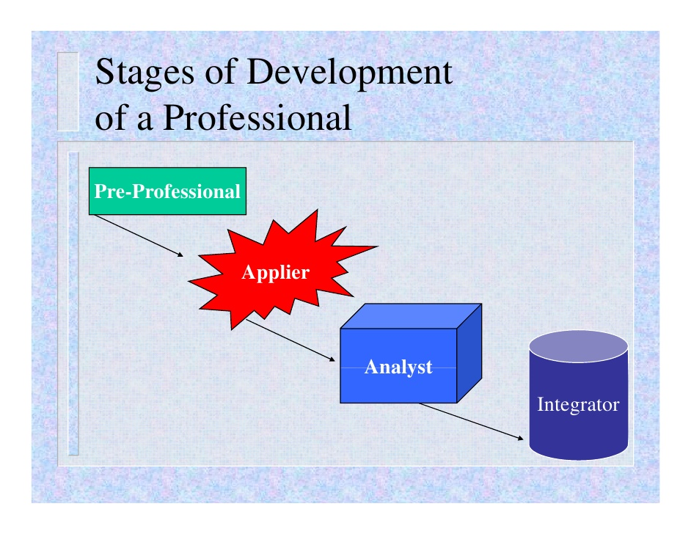
အတုျမင္ကာလ
အတတ္သင္ကာလ
စမ္းစစ္မႈကာလ
ဘက္စံု သမူဟ

Slide 21
ပံုရိပ္ သြင္ျပင္ လကၡဏာ
ဆက္ဆံေရး
အလုပ္ၾကြမ္းၾကင္မႈ
ကိုယ္နႈတ္အမူအရာ

Slide 22
ယံုၾကည္ရမႈ
ၾကြမ္းၾကင္မႈ
ကိုယ္ျခင္းစါမႈ
ေလးစါးတတ္မႈ
ဂရုတစိုက္ ရွိမႈ

Slide 23
ကုသေရး အ၀ိုင္းအ၀န္ တြင္းသာ
အႏၱရယ္ကင္းေသာ ယံုၾကည္ရေသာ အေျခခံ
ဆက္ဆံေရးေဘာင္
ၾသဇါ ပါ၀ါ မညီမွ်မႈ။

Slide 24
လိုအပ္မႈ
ယံုၾကည္ ကိုးကြယ္မႈ
ပူပန္မႈ
တန္ဖိုးထားမႈ

Slide 25
လူမႈ ဆက္ဆံေရး
မေလွ်ာ္ ဆက္သြယ္မႈ
မေလွ်ာ္ေသာ ဖြင့္ဟမႈ
အျမတ္ထုတ္မႈ
လွ်ဳိ ့၀ွက္ထားရမည္ကို ခ်ိုဳးေဖါက္ျခင္း။

Slide 26
စိတ္ခ် ယုံၾကည္ ရေသာ
လုပ္ငန္း ကၽြမ္းက်င္မႈ ရွိေသာ
အေထာက္အကူ ေပးေသာ
ေလးစါမႈရွိေသာ
တာ၀န္ခံေသာ

Slide 27
လုပ္ငန္းသေဘာအရ ယံုၾကည္ရျခင္း
အျပန္အလွန္ ေလးစါးျခင္း
ပြင့္လင္းေသာ ဆက္ဆံမႈ ရွိျခင္း
့

Slide 28
လုပ္ငန္း ကၽြမ္းက်င္မႈ ရွိသည္
စိတ္ခ် ယုံၾကည္ ရသည္
အရာရာ ေလးစါး သမႈရွိသည္
တည္ၾကည္သည္
ေထာက္ထား ညွာတာသည္
ကိုယ္ျခင္းစါ တရား ရွိသည္

Slide 29
ရည္မြန္ ယဥ္ေက်း ျပဴငွါသည္
အားကိုးေလာက္သည္
ပူးေပါင္း ေဆာင္ရြက္တတ္သည္
လုပ္ငန္းတြင္ နွစ္ထားသည္

